Slide 1

Iris flower classification model
PRESENTED BY
STUDENT NAME : DURGA PRASAD ANNAMDEVULA
COLLEGE NAME : Aditya degree college rajahumundry
DEPARTMENT : BCA
EMAIL ID : durgaprasadannamdevula41@gmail.com
AICTE STUDENT ID: AINSI_108527

Slide 2
OUTLINE
Introduction
Data set
Proposed system / solution
System approach
Classification models
Algorithm and deployment
Code

Slide 3
Result
Conclusion
Future scope

Slide 4
INTRODUCTION
The goal of this project is to create a model that can be accurately predict the species of an iris Flower based on It’s sepal length, sepal width, petal length and petal width.
In this we can building a machine learning model for iris flower classification and highlight the some of the key techniques used.

Slide 5
DATA SET
The Iris Flower dataset is a classic dataset in machine learning that contains measurements for 150 iris flowers from three different species:
Setosa
Versicolor
Virginica

Slide 6
Each flower is described by four features :
Sepal length
Sepal width
Petal length
Petal width
The dataset is commonly used as a benchmark for machine learning Algorithms.

Slide 7
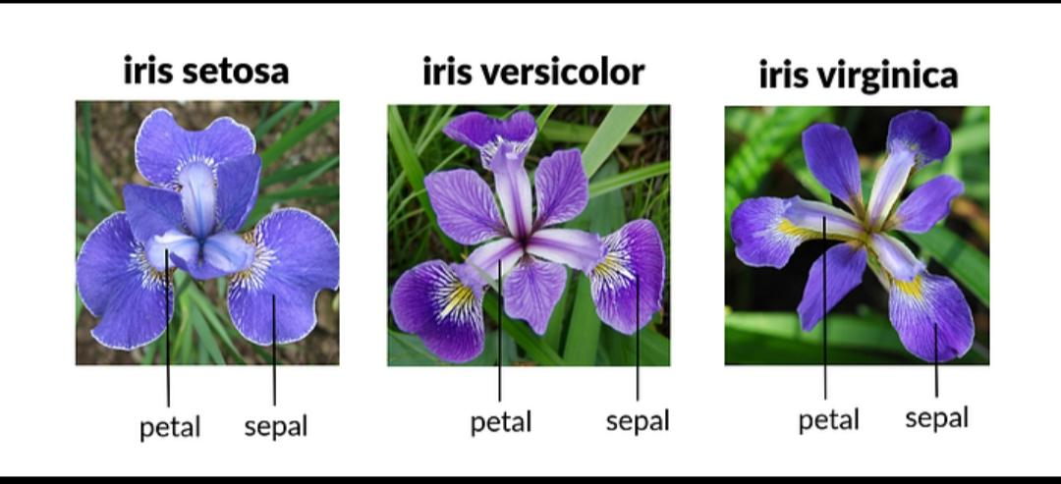

Slide 8
Proposed system
A typical system development approach for an Iris flower classification project involves several key stages: data collection and preparation, exploratory data analysis (EDA), model building, evaluation, and deployment. The goal is to train a machine learning model to accurately predict the Iris species based on measurements like sepal and petal length and width.

Slide 9
System approach
Data Preparation: Load the Iris dataset and split it into training and testing sets. Feature Engineering: Explore the dataset to understand the relationships between features and the target variable (species). Model Selection: Choose an appropriate classification algorithm based on the nature of the data and the desired performance. Model Training: Train the selected model on the training data. Model Evaluation: Evaluate the model’s performance on the testing data using metrics like accuracy, precision, recall, and F1-score. Hyperparameter Tuning: Optimize the model’s parameters to improve its performance. Prediction: Use the trained model to predict the species of new, unseen iris flower samples.

Slide 10
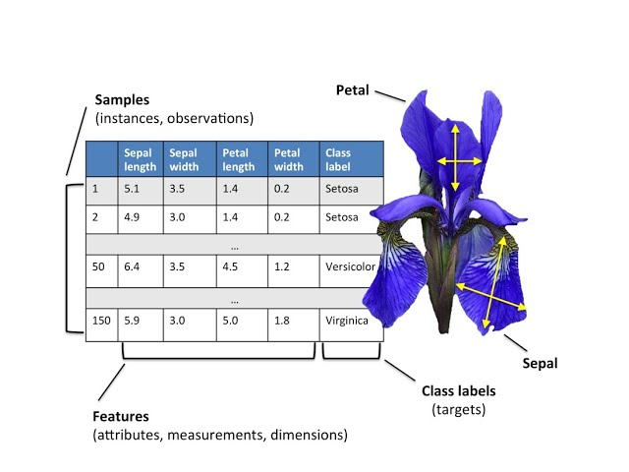
Classification model

Slide 11
Algorithms and deployment
For the Iris flower classification project, suitable algorithms include K-Nearest Neighbours (KNN), Logistic Regression, Support Vector Machines (SVM), and Decision Trees
Deployment: Implement the trained model in production to demonstrate the viability of the model in iris flower classification tasks. For the implementation of iris flower classification using machine learning, we utilized the renowned Iris dataset available in the UCI Machine Learning Repository.

Slide 12
Code
From sklearn.datasets import load_iris from sklearn.model_selection import train_test_split from sklearn.ensemble import RandomForestClassifier from sklearn.metrics import classification_report Load Iris dataset iris = load_iris() X = iris.data y = iris.target

Slide 13
Split the data X_train, X_test, y_train, y_test = train_test_split( X, y, test_size=0.2, random_state=42 ) Train a Random Forest model model = RandomForestClassifier() model.fit(X_train, y_train)

Slide 14
Make predictions y_pred = model.predict(X_test)

Slide 15
RESULT
Output the results
Print(“Classification Report :\n”)
Print (classification _ report( y test , y pred, target names = iris. target_names))

Slide 16
Classification Report:
precision recall f1-score support
setosa 1.00 1.00 1.00 10
versicolor 1.00 0.90 0.95 10
virginica 0.91 1.00 0.95

Slide 17
Accuracy 0.97 30 macro avg 0.97 0.97 0.97 30 weighted avg 0.97 0.97 0.97 30 This shows the model has about 97% accuracy.

Slide 18
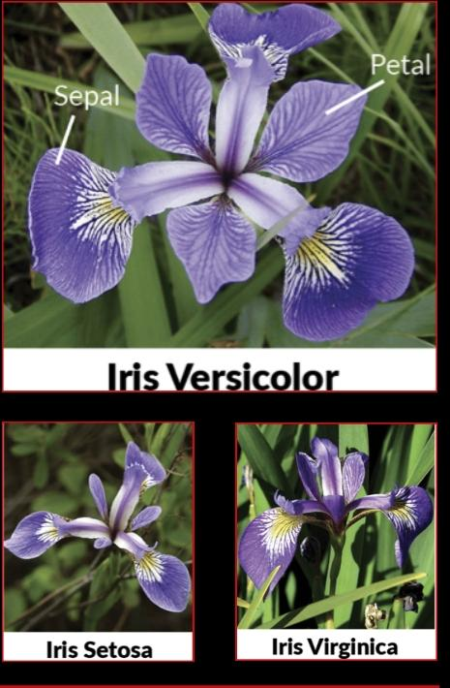

Slide 19
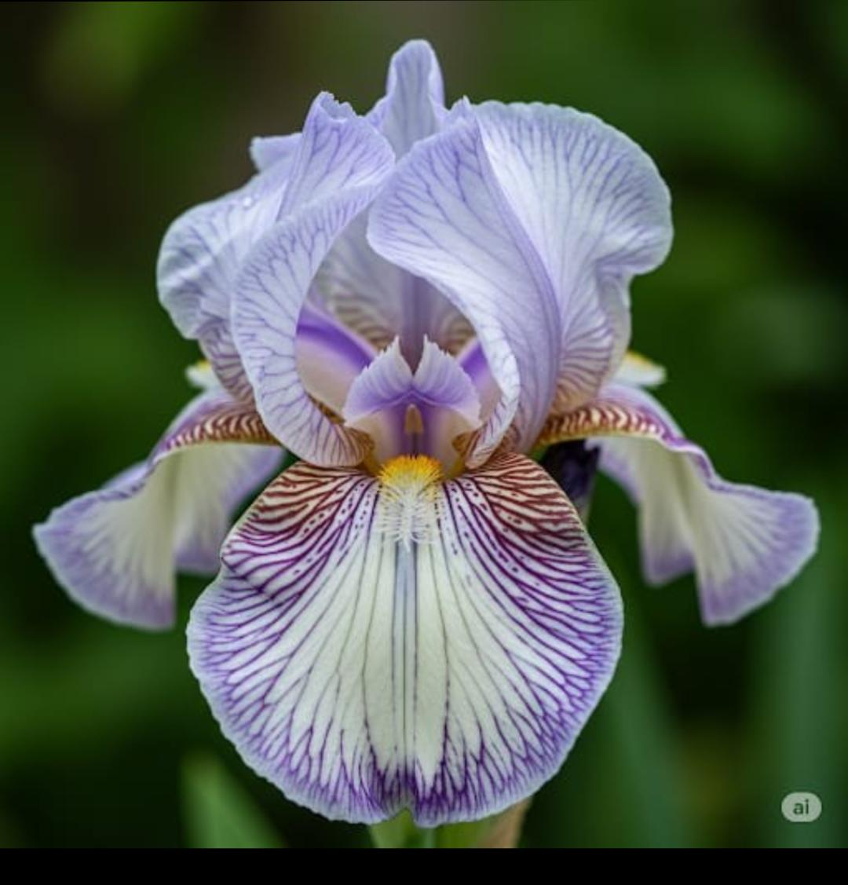
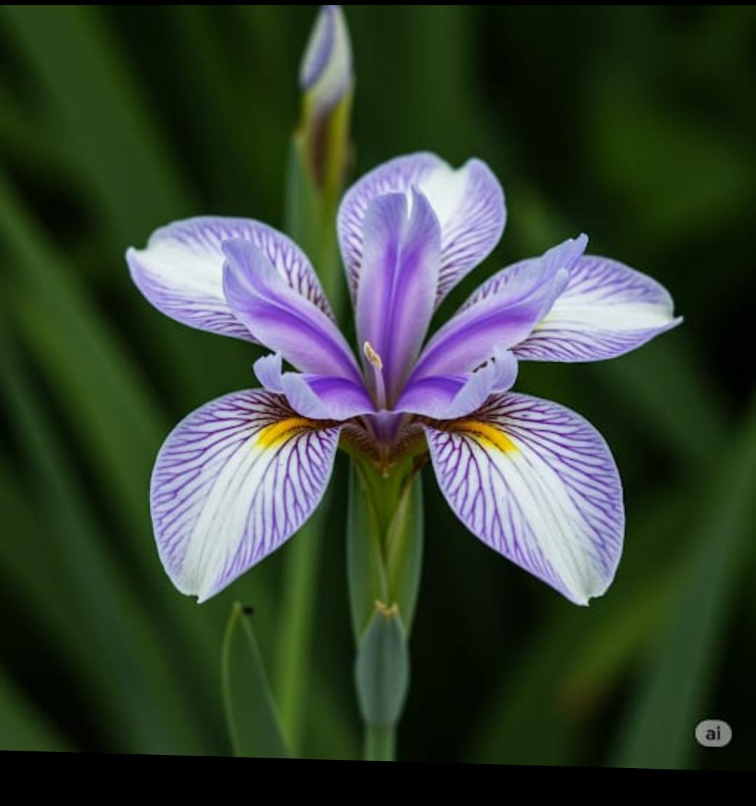

Slide 20
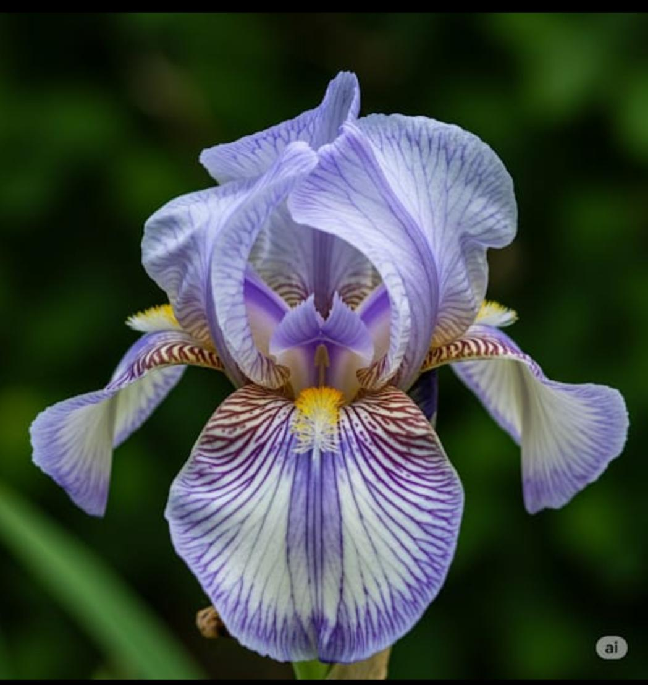

Slide 21
Conclusion
The project demonstrates the effectiveness of various machine learning algorithms in classifying Iris flowers and provides insights into model selection, data preprocessing, and evaluation.

Slide 22
Future scope
The future scope for an Iris classification project lies in expanding its application beyond basic species identification. This includes exploring new machine learning techniques, utilizing more diverse datasets, and integrating the model into practical real-world scenarios.

Slide 23
Thank you

